Slide 1


Linked Lists
Dr. Tahir Maqsood
node
data
pointer

Slide 2

Outline
Static vs Dynamic Data Structure
  Limitations of List ADT with Array Implementation.
Dynamic List (Linked lists)
Variations of linked lists
  Single linked lists
  Circular linked lists
  Doubly linked lists
Basic operations of linked lists
  Insert
    Iinsert at start
    Insert at end
    Insert at specific position
  delete,
  print, find etc.

Slide 3
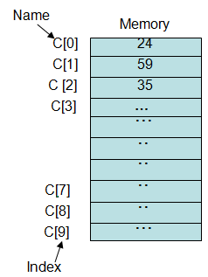
Array Limitations
What are the limitations of an array, as a data structure?
  Fixed size(e.g. int L[10])
    What is the drawback of fixed size?
    Can not grow or shrink as needed
    Solution: Use dynamic Data Structure
  Physically stored in consecutive memory locations
    What is drawback of consecutive memory
    Suppose we need 10 memory location
    The 10 locations are available but not consecutive
    Solution: store elements where space available

Slide 4

Linked Data Structures
How we ensure these two solutions?
  Use Linked Data Structure
  A linked data structure consists of items that are linked to other items(how?)
  each item points to another item
Now what is linked list?
  A linked list is an ordered sequence of items called nodes
  Each node contains at least
    A piece of data (any type)
    Pointer to the next node in the list
node
data
pointer

Slide 5
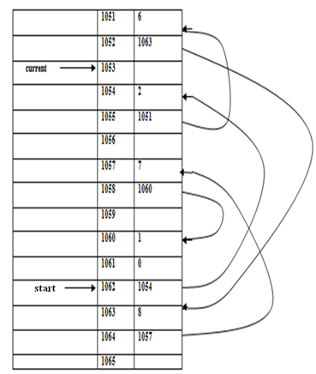
Linked Data Structures
In linked list, adjacency between the elements are maintained by means of link or pointers

Slide 6


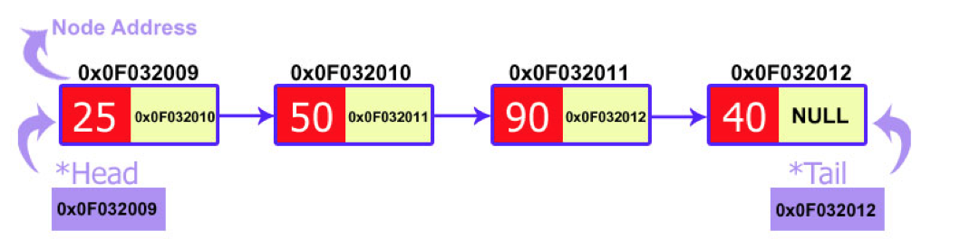
Conceptual Diagram of a Singly-Linked List
A
∅
Head
The first item (node) in the linked list is accessed via a front or head pointer
  The linked list is defined by its head (this is its starting point)
Head: pointer to the first node
The last node points to NULL

Slide 7
Conceptual Diagram of a Singly-Linked List
head pointer "defines" the linked list
(note that it is not a node)
head
these are nodes
.
data
data
data

Slide 8
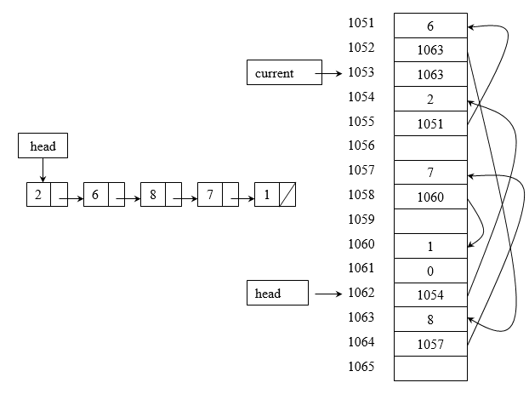
Linked List inside Computer Memory
Conceptual diagram
Linked list in memory

Slide 9
Advantages of Linked Lists
The items do not have to be stored in consecutive memory locations: the successor can be anywhere physically
  So, can insert and delete items without shifting data
  Can increase the size of the data structure easily
Linked lists can grow dynamically (i.e. at run time) – the amount of memory space allocated can grow and shrink as needed

Slide 10


Variations of Linked Lists
Singly linked list: each item points to the next item
Circular or Non circular
A
∅
Head
A
B
C
Head

Slide 11



Variations of Linked Lists
Doubly linked list: each item points to the next item and to the previous item
∅
∅
Head

Slide 12
Implementation of Linked List Using C++
Declare Node structure for the nodes
  data: int-type data e.g. example
  link: a pointer to the next node in the list
struct Node
{
int data; // data
Node* link; // pointer to next
};
node
data
link

Slide 13
Creating single Linked List
;
We use two important pointers, i.e. head and tail
  head points to first node
  tail points to last node.
Demo
Initially Linked list has no node, i.e. Linked list is empty
  It means if the head is equal to NULL then we can conclude that the linked list is empty.
head
NULL
tail
NULL
4-<number>

Slide 14
Creating single Linked List
;
head
100
node *temp=new node;
temp->data=value;
temp->link=NULL;
100
if(head==NULL)
{
head=temp;
tail=temp;
temp=NULL;
}
50
NULL
if there is just one node in linked lists, then it is called both head and tail.
tail
100
head
100
100
200
else
{
tail->link=temp;
tail=temp;
}
50
200
55
NULL
tail
200
4-<number>

Slide 15
Creating single Linked List
;
node *temp=new node;
temp->data=value;
temp->link=NULL;
head
100
100
200
50
200
55
NULL
head
tail
200
100
100
200
300
50
200
50
300
40
NULL
if(head==NULL)
{
head=temp;
tail=temp;
temp=NULL;
}
else
{
tail->link=temp;
tail=temp;
}
tail
300
4-<number>

Slide 16
Creating single Linked List
;
Now, we will write a function for creating LinkedList( node will be inserted at end)
void createnode(int value)
{
node *temp=new node;
temp->data=value;
temp->link=NULL;
if(head==NULL)
{
head=temp;
tail=temp;
temp=NULL;
}
else
{
tail->link=temp;
tail=temp;
}
}
4-<number>

Slide 17
Creating single Linked List
;
void createnode(int value)
{
temp
100
node *temp=new node;
temp->data=value;
50
temp->next=NULL;
50
NULL
if(head==NULL)
{
head=temp;
tail=temp;
temp=NULL;
}
head
100
100
50
NULL
else
{
tail->next=temp;
tail=temp; }
}
tail
100
100
100
200
50
200
55
NULL
tail
200

Slide 18
Displaying single Linked List
Now we have a working linked list which allows creating nodes.
If we want to see that what is placed in our linked list then we will have to make a display function.
4-<number>

Slide 19
Displaying single Linked List
The logic behind this function is that:
  Make a temporary node
  pass the address of the head node to it.
  Now we want to print all the nodes on the screen. So we need a loop which runs as many times as nodes exist.
    Every node contains the address of the next node so the temporary node walks through the whole linked list.
    If the temporary node becomes equal to NULL then the loop would be terminated.
node *temp=new node;
temp=head;
while(temp!=NULL)
{
Print “temp->data";
temp=temp->link;
}

Slide 20
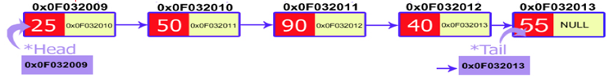
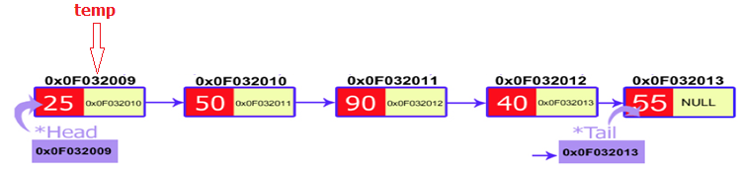
Displaying single Linked List
25
void display()
{
node *temp=new node;
temp
temp=head;
temp
0x0F032009
while(temp!=NULL)
{
cout<<temp->data<<"\t";
25
temp=temp->link;
temp
0x0F032010
}
}

Slide 21
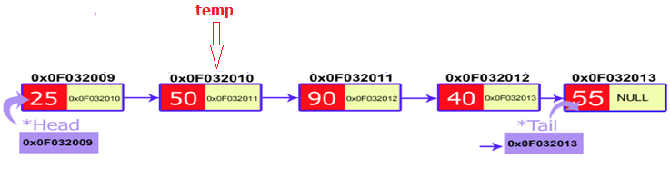
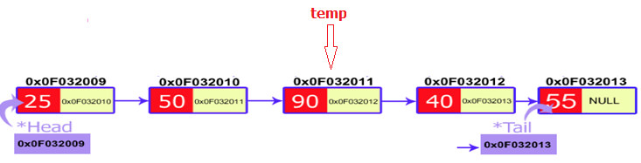
Displaying single Linked List
void display()
{
25, 50
node *temp=new node;
temp=head;
while(temp!=NULL)
{
temp
0x0F032010
cout<<temp->data<<"\t";
50
temp=temp->link;
temp
0x0F032011
}
}

Slide 22
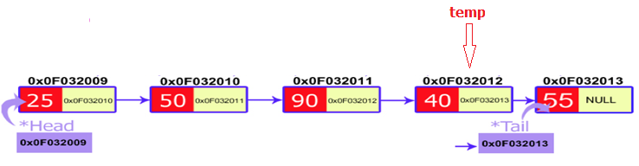
Displaying single Linked List
void display()
{
25, 50,90
node *temp=new node;
temp=head;
while(temp!=NULL)
{
temp
0x0F032011
cout<<temp->data<<"\t";
90
temp=temp->link;
temp
0x0F032012
}
}

Slide 23
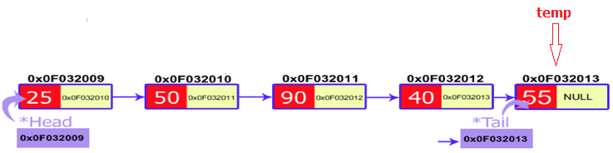
Displaying single Linked List
void display()
{
25, 50,90,40
node *temp=new node;
temp=head;
while(temp!=NULL)
{
temp
0x0F032012
cout<<temp->data<<"\t";
40
temp=temp->link;
temp
0x0F032013
}
}

Slide 24
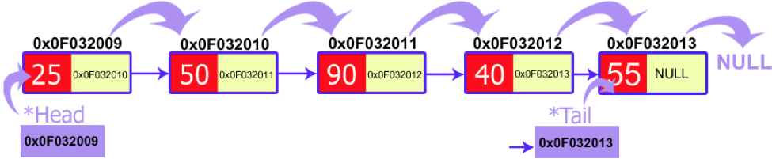
Displaying single Linked List
void display()
{
25, 50,90,40,55
node *temp=new node;
temp=head;
while(temp!=NULL)
{
temp
0x0F032013
cout<<temp->data<<"\t";
55
temp=temp->link;
temp
NULL
}
}

Slide 25
Displaying single Linked List
void display()
{
node *temp=new node;
temp=head;
while(temp!=NULL)
{
temp
NULL
cout<<temp->data<<"\t";
temp=temp->link;
}
}
25, 50,90,40,55

Slide 26
Operations on single Linked List
We will now examine linked list operations:
Insert an item to the linked list
  We have 3 situations to consider:
    insert a node at the front
    insert a node at the end(Already done)
    insert a node at particular position
Delete an item from the linked list
  We have 3 situations to consider:
    delete the node at the front
    delete an interior node
    delete the last node
4-<number>

Slide 27
Inserting a Node
The following steps are involved in inserting an element into linked list
Creation of the node
  Before insertion, the node is created. Using new operator memory space for the node is allocated
Assignment of data
  Once the node is created, data values are assigned to members
Adjusting pointers
  The insertion operation changes the sequence.
  Hence, according to the sequence the address of the next elements is assigned to the inserted node. The address of the current node (inserted node) is assigned to the previous node.
4-<number>

Slide 28
Inserting a Node at the front
It is just a 2-step algorithm which is performed to insert a node at the start of a singly linked list.
  Created a node called temp
  Connect the newly created node to the first node,
    This can be achieved by putting the address of the head in the link field of the new node.
  New node should be considered as a head.
    It can be achieved by declaring head equals to a new node.
4-<number>

Slide 29

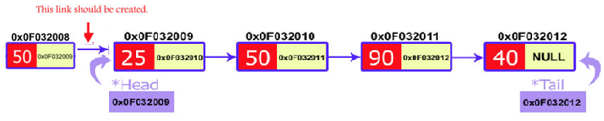
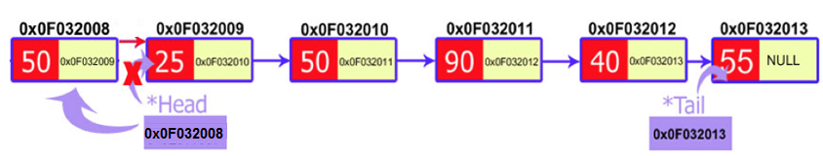
Inserting a Node at the front
Create a node
node *temp=new node;
temp->data=value;
temp
2. Make the new node point to the first node (i.e. the node that head points to)
temp->link=head;
3. Make headt point to the new node (i.e the node that node points to)
head=temp;
4-<number>

Slide 30
Inserting a Node at the front
void insert_start(int value)
{
node *temp=new node;
temp
temp->data=value;
85
temp->link=head;
85
100
head=temp;
}
head
head
101
100
100
200
300
85
100
50
200
50
300
40
tail
300
4-<number>

Slide 31
Inserting a Node at the end
;
The insertion of a new node at the end of linked list has 2 steps:
Create a node called temp
Linking the newly created node with tail node.
  This can be achieved by assigning the address of a new node to the link filed of a tail node.
The tail pointer should always point to the last node.
  This can be achieved by assigning the address of a new node to tail pointer.
4-<number>

Slide 32

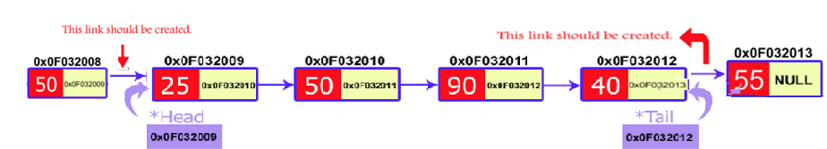
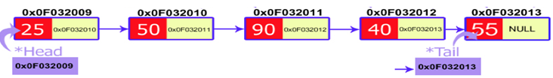
Inserting a Node at the end
node *temp=new node;
temp->data=value;
Create a node
2. Make the new node last node
temp->link=NULL;
tail-> link = temp;
temp
3. Make tail point to the new node (i.e the node that node points to)
tail= temp;
4-<number>

Slide 33
Inserting a Node at Specific
In this case, the new node is inserted between two consecutive nodes.
  We will access these nodes by asking the user at what position (s)he wants to insert the new node.
We call one node as current and the other as previous, and the new node is placed between them.
4-<number>

Slide 34
Inserting a Node at Specific
head
500
500
600
700
800
85
600
65
700
50
800
40
NULL
node *pre=new node;
tail
pre
node *cur=new node;
cur
4-<number>

Slide 35
Inserting a Node at Specific
;
We initialized our current node by the head
650
head
500
500
600
700
800
85
600
65
700
50
800
40
NULL
cur
tail
cur=head;
cur
500
4-<number>

Slide 36
Inserting a Node at Specific
;
Now, we will start a loop to reach those specific nodes.
We move current node through the linked list
head
500
650
temp
500
600
700
800
85
600
65
700
50
800
40
NULL
for(int i=1;i<pos;i++)
{
tail
pre
pre=cur;
cur
}
cur=cur->link;
4-<number>

Slide 37
Inserting a Node at Specific
;
Now, we will start a loop to reach those specific nodes.
We move current node through the linked list
head
500
650
temp
500
600
700
800
85
600
65
700
50
800
40
NULL
for(int i=1;i<pos;i++)
{
tail
pre=cur;
pre
cur
}
cur=cur->link;
4-<number>

Slide 38
Inserting a Node at Specific
Now, we will start a loop to reach those specific nodes.
We move current node through the linked list
head
500
650
45
temp
500
600
700
800
85
600
65
700
50
800
40
NULL
temp->data=value;
tail
pre
cur
4-<number>

Slide 39
Inserting a Node at Specific
;
Now the new node can be inserted between the previous and current node by just performing two steps:
  Pass the address of the new node in the link field of the previous node.
  Pass the address of the current node in the link field of the new node.
pre->link=temp;
temp->link=cur;
650
temp
head
500
45
700
500
600
700
800
85
600
650
40
NULL
65
700
50
800
pre
cur
4-<number>
tail

Slide 40
Inserting a Node at Specific
;
head
500
45
700
500
600
700
800
85
600
700
40
NULL
65
650
50
800
tail
head
500
500
600
650
700
800
85
600
65
650
45
700
50
800
40
NULL
tail
4-<number>

Slide 41
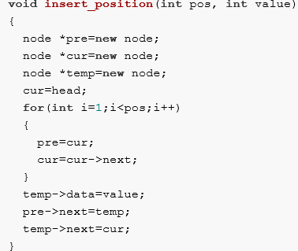
Inserting a Node at Specific
;
4-<number>

Slide 42
Deleting a node from Linked List
;
There are also three cases in which a node can be deleted:
  Deletion at the start
  Deletion at the end
  Deletion at a particular position
4-<number>

Slide 43
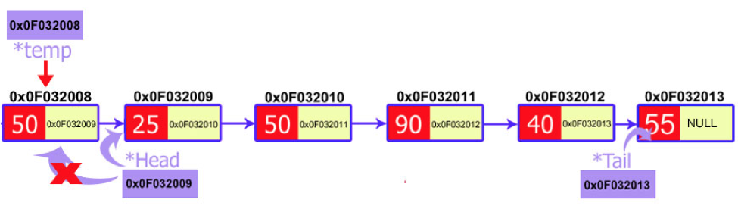
Deleting a node from start
The process of deletion includes:
  Declare a temp pointer and pass the address of the first node, i.e. head to this pointer.
  Declare the second node of the list as head as it will be the first node of linked list after deletion.
  Delete the temp node.
Step -1
node *temp=new node;
temp=head;
Step -2
head=head->link;
Step -3
delete temp
4-<number>

Slide 44
Deleting a node from end
;
In the case find a node that comes before the last node.
  This can be achieved by traversing the linked list.
  We would make two temporary pointers(previous and current) and let them move through the whole linked list.
  At the end, the previous node will point to the second to the last node and the current node will point to the last node, i.e. node to be deleted.
We would delete current node and make the previous node as the tail.
4-<number>

Slide 45
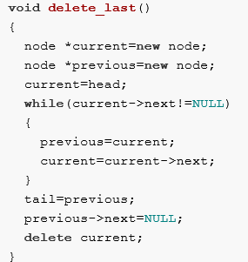
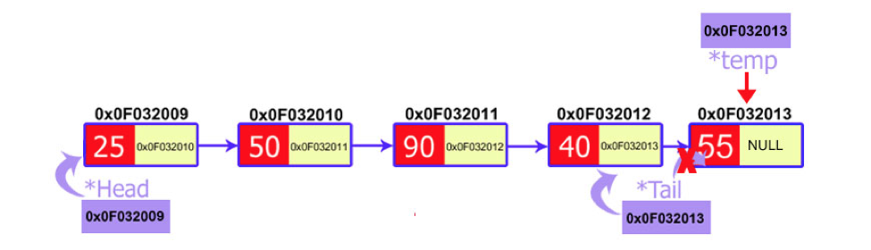
Deleting a node from end
;
4-<number>

Slide 46
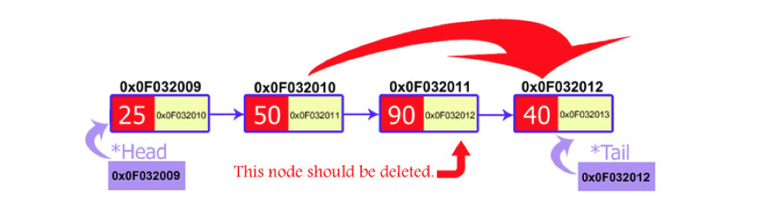
Deleting a node from specific position
;
We ask the user to input the position of the node to be deleted.
After that:
  Just move two temporary pointers(previous and current) through the linked list until we reach our specific node.
  Established the link between previous and next node.
    pass the address of the node that is after current node to the previous pointer.
  delete current node
pre
cur
next

Slide 47
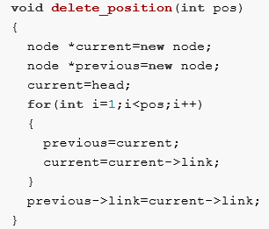
Deleting a node from specific position
;
pre
cur
next

Slide 48
Analysis of Link List
As stated earlier, we will be going to analyze each data structure.
We will see whether it is useful or not.
  We will see its cost and benefit with respect to time and memory.
Let us analyze the link list which we have created with the dynamic memory allocation in a chain form.

Slide 49
Insertion operation
Dynamic List(Linked List | Static List(Array Based)
Insert at start: we simply insert the new node after the current node. So ‘add’ is a one-step operation. | Insert at start: Suppose if we have to insert the element in the start of the array, all the elements to the right one spot are shifted.
Insert at end: We insert a new node after the current node in the chain. | Insert at end: Suppose if we have to insert the element in the start of the array, all the elements to the left one spot are shifted.
Insert at specific position: For this, we have to change two or three pointers while changing the values of some pointer variables. | Insert at specific position: if we have to add an element in the centre of the array, the space for it is created at first. For this, all the elements that are after the current pointer in the array, should be shifted one place to the right.

Slide 50
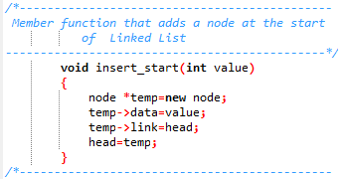
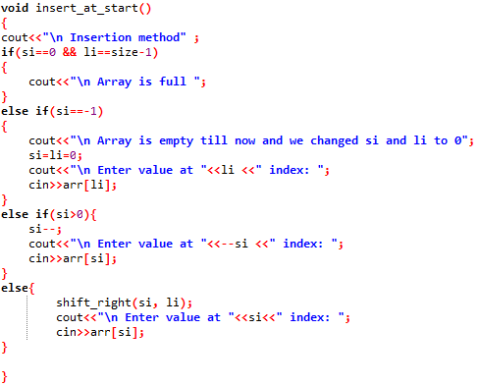
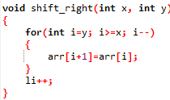
Insertion operation

Slide 51
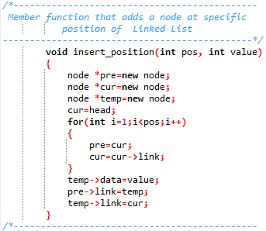
Insertion operation

Slide 52
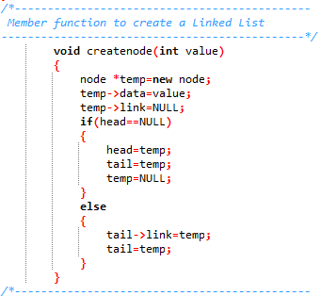
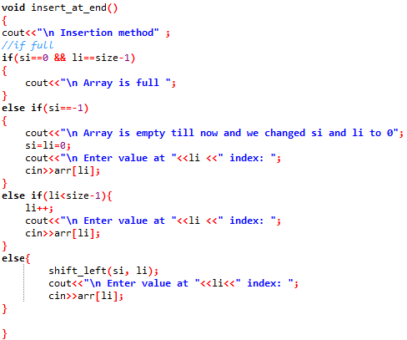
Insertion operation

Slide 53
Deletion operation
Dynamic List(Linked List | Static List(Array Based)
Delete from start: we simply insert the new node after the current node. So ‘add’ is a one-step operation. | Delete from start: Suppose if we have to insert the element in the start of the array, all the elements to the right one spot are shifted.
Delete from end: We insert a new node after the current node in the chain. | Delete from end: Suppose if we have to insert the element in the start of the array, all the elements to the left one spot are shifted.
Delete from specific position: For this, we have to change two or three pointers while changing the values of some pointer variables. | Delete from specific position: if we have to add an element in the center of the array, the space for it is created at first. For this, all the elements that are after the current pointer in the array, should be shifted one place to the right.

Slide 54
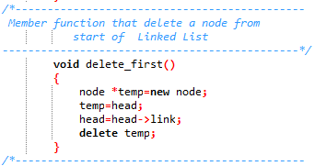
Deletion operation

Slide 55
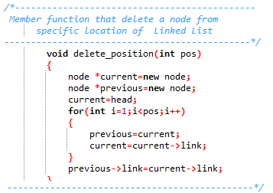
Deletion operation

Slide 56
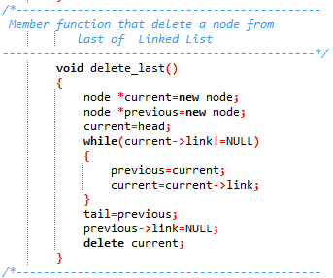
Deletion operation

Slide 57
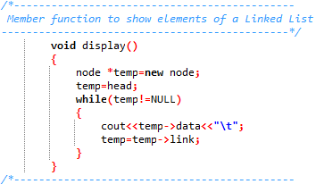
Display Function

Slide 58
CONCLUSION

Slide 59
Array versus Linked List
Linked lists are more complex to code and manage than arrays, but they have some distinct advantages.
  Dynamic: a linked list can easily grow and shrink in size.
    We don’t need to know how many nodes will be in the list. They are created in memory as needed.
    In contrast, the size of a C++ array is fixed at compilation time.
  Easy and fast insertions and deletions
    To insert or delete an element in an array, we need to copy to temporary variables to make room for new elements or close the gap caused by deleted elements.
    With a linked list, no need to move other nodes. Only need to reset some pointers.

